Slide 1


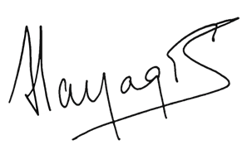
 | Stellar Optics Private Limited | SOPL – AQMS- 03
 | QUALITY POLICY
Stellar Optics Private Limited is committed to delivering precision optical components and solutions that strive to exceed meet customer expectations in quality, performance, and reliability.
Our commitment to excellence drives every aspect of our operation, from designing and fabrication to testing and delivering. To achieve this, we focus on Customer, Sustainability and Responsibility, Employee Engagement, Continuous Improvement, Quality & Innovation.
Jan 2025
Rev. No :00
Director

